Slide 1
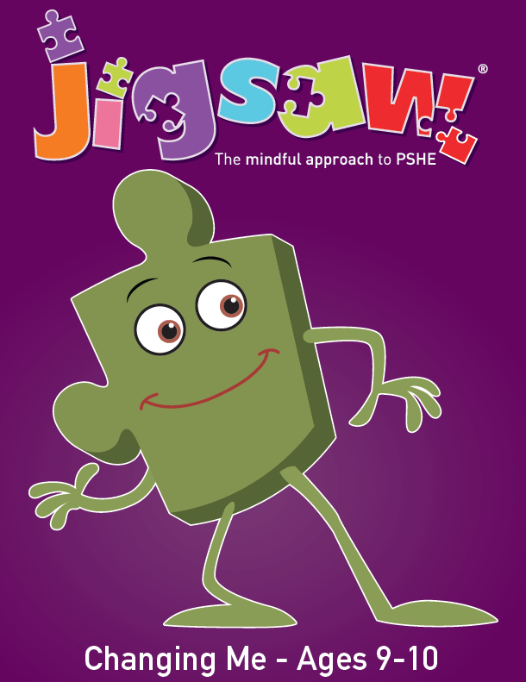

Year 5 PSHE
Jigsaw Unit 6
Changing Me

Slide 2
Agenda:
Outline of the PSHE Scheme of Work (Jigsaw)
Lesson Objectives for each lesson
Key Vocabulary covered
Images and animations used for this unit
Questions

Slide 3
Designed as a whole-school approach, Jigsaw PSHE / Health and Well-being provides a detailed and comprehensive scheme of learning for ages 3-16.
Jigsaw is a unique, spiral, progressive and effective scheme of work, aiming to prepare children/young people for life, helping them really know and value who they are and understand how they relate to other people in this ever-changing world.
Notes:
We have a whole school approach to teaching PSHE and we follow a PSHE scheme called Jigsaw. Each term is allocated a puzzle piece which is titled the same across the school but covers topics appropriate for each year group. The puzzle piece for this term is called ‘Changing me’. The children begin with lesson 1 one after the half term where they discuss body image.

Slide 4
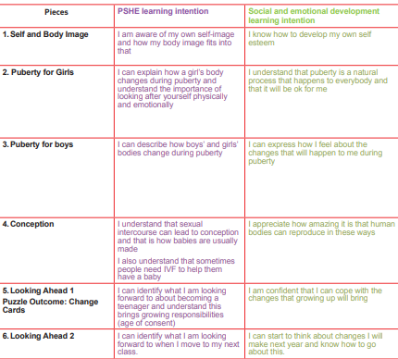
Lesson objectives
(from the Jigsaw scheme of work):
Notes:
On the screen now are the lesson objectives for the next few lessons. The purple objectives are knowledge and understanding based and the green are linked to social and emotional outcomes.

Slide 5
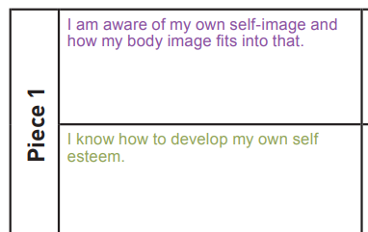

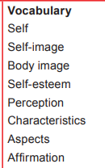
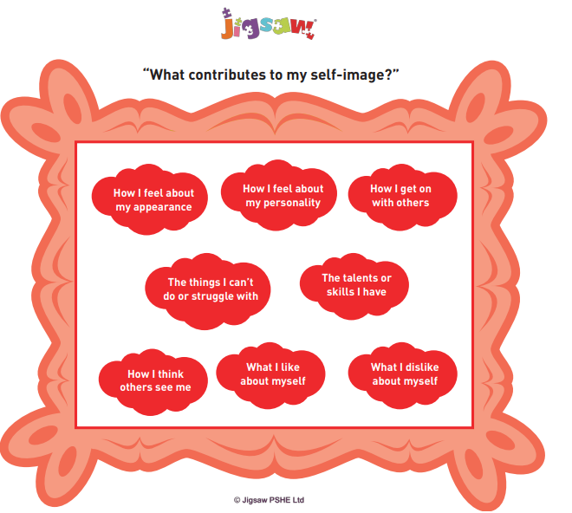
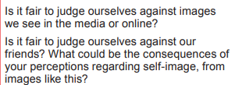
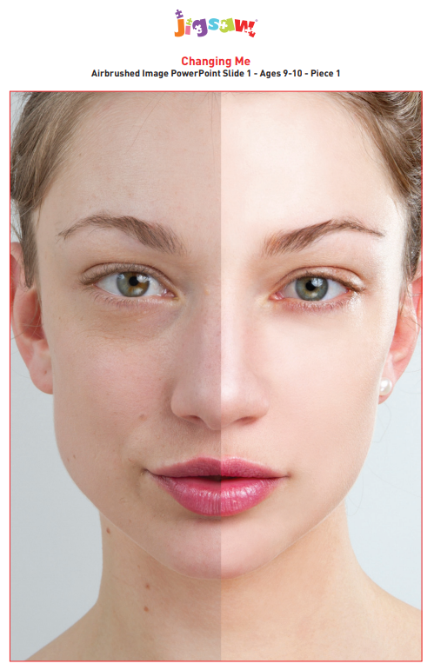
Key questions:

Slide 6
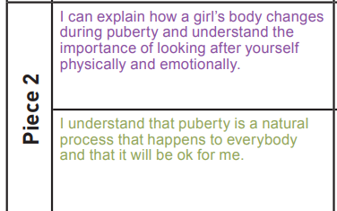
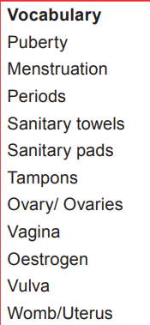
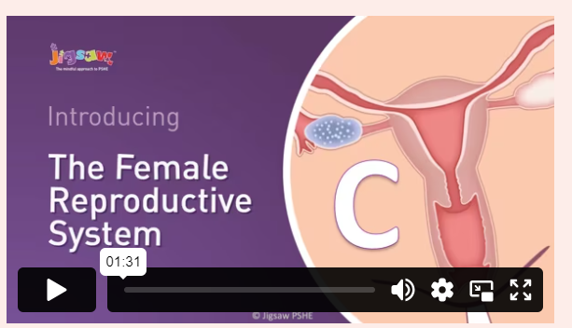
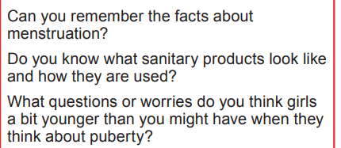
Key questions:
https://jigsawpshe.online/umbraco/Surface/Presentation/CommunityVideo?title=Animation%20C&type=Vimeo&url=https%3A%2F%2Fplayer.vimeo.com%2Fvideo%2F504433723

Slide 7
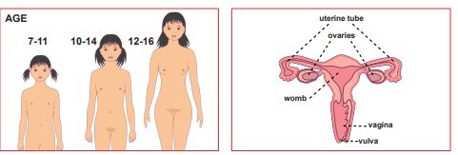
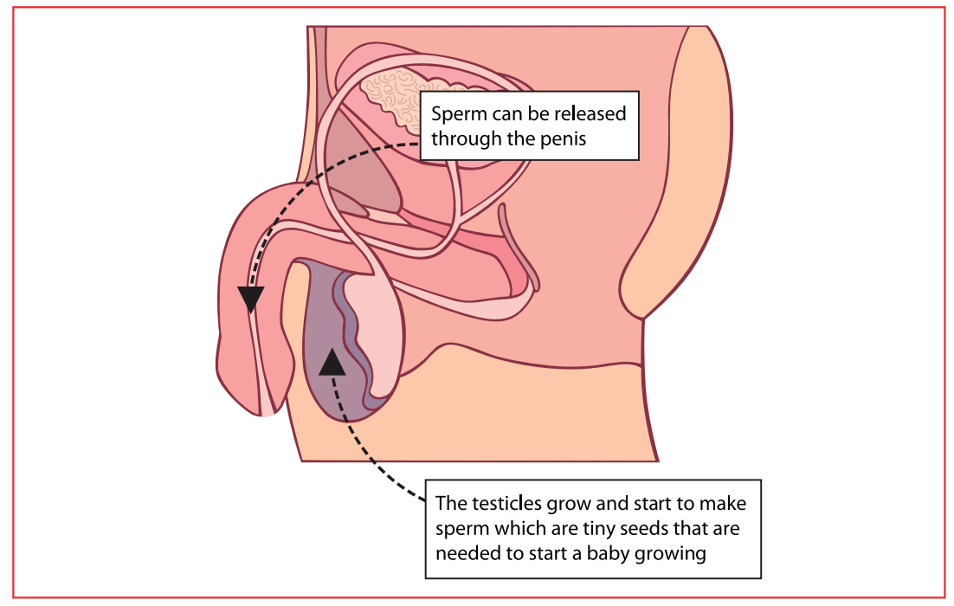
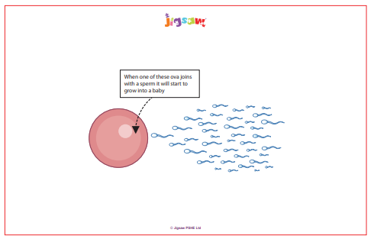
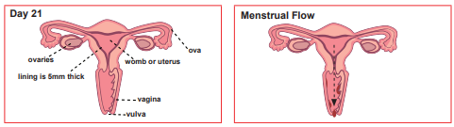
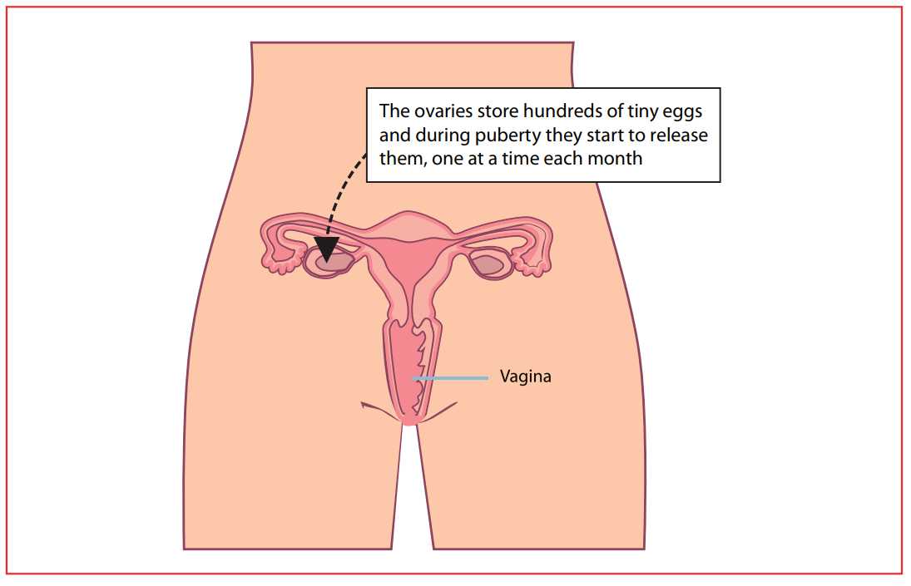
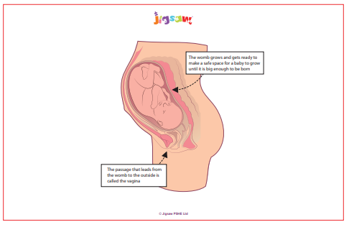
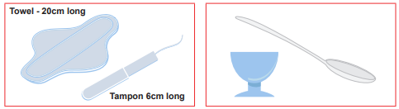

Slide 8
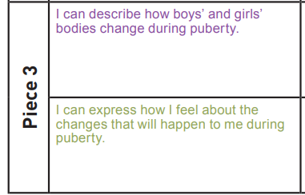
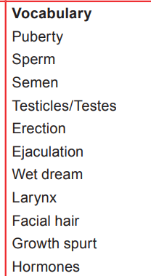

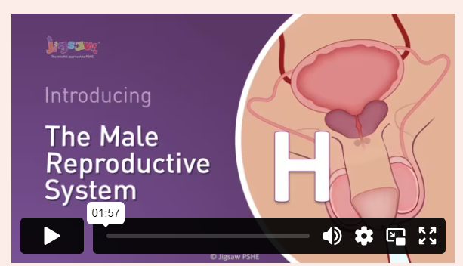

Key questions:
https://jigsawpshe.online/umbraco/Surface/Presentation/CommunityVideo?title=Animation%20H&type=Vimeo&url=https%3A%2F%2Fplayer.vimeo.com%2Fvideo%2F504434208

Slide 9
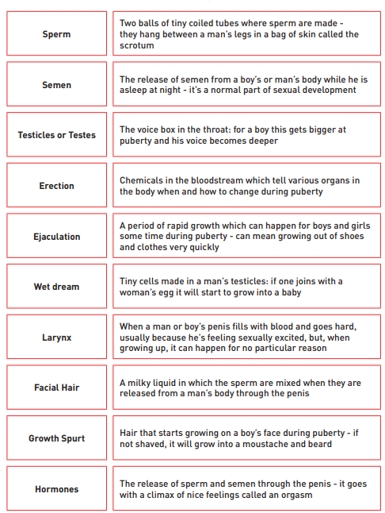
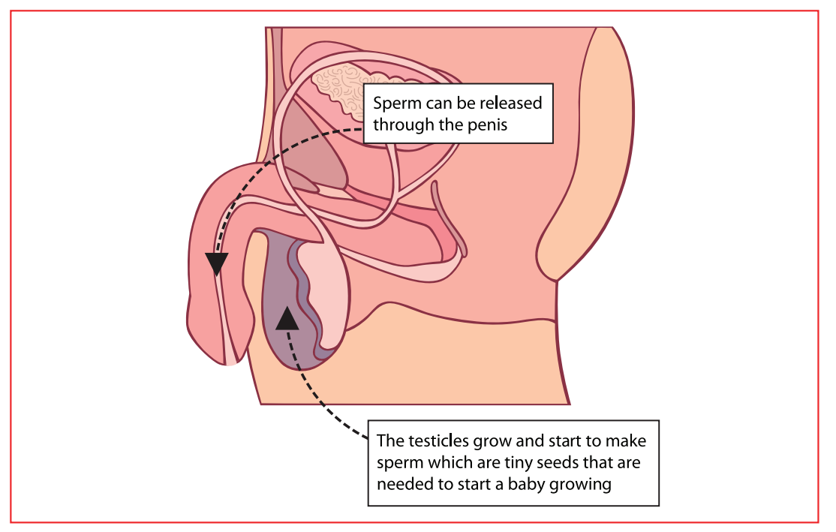

Slide 10
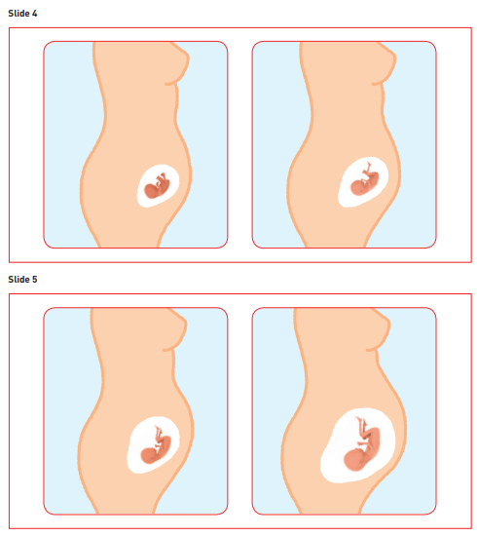
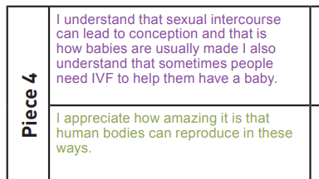
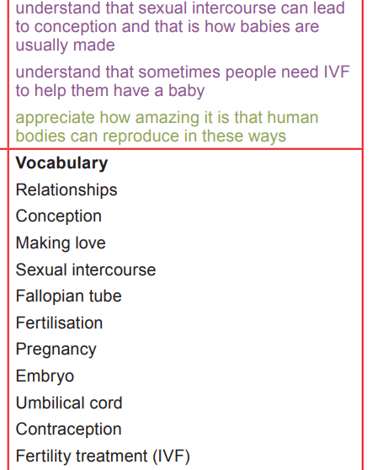

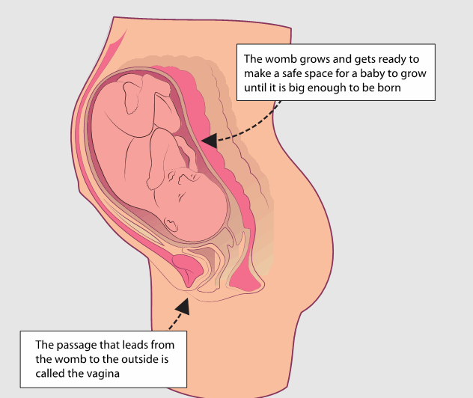


Key questions:

Slide 11
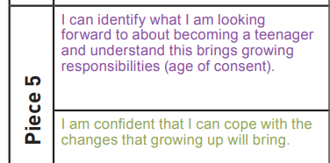
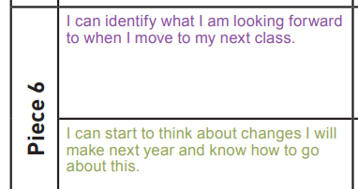
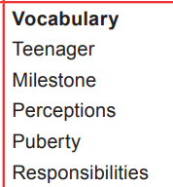
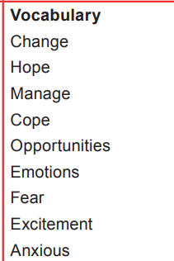
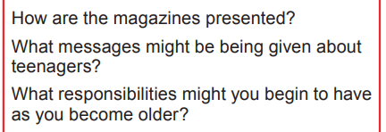
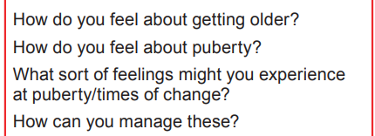
Key questions:

Slide 12

Year 5 PSHE
Jigsaw Unit 6
Changing Me

