Slide 1
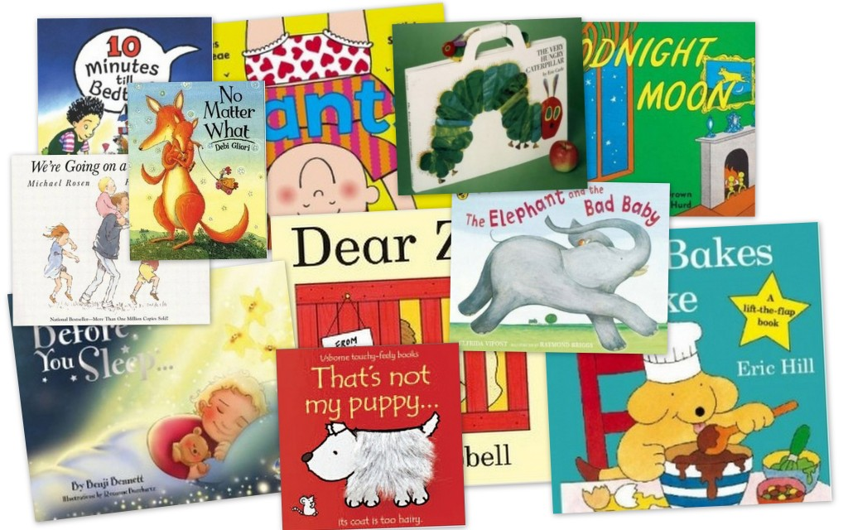
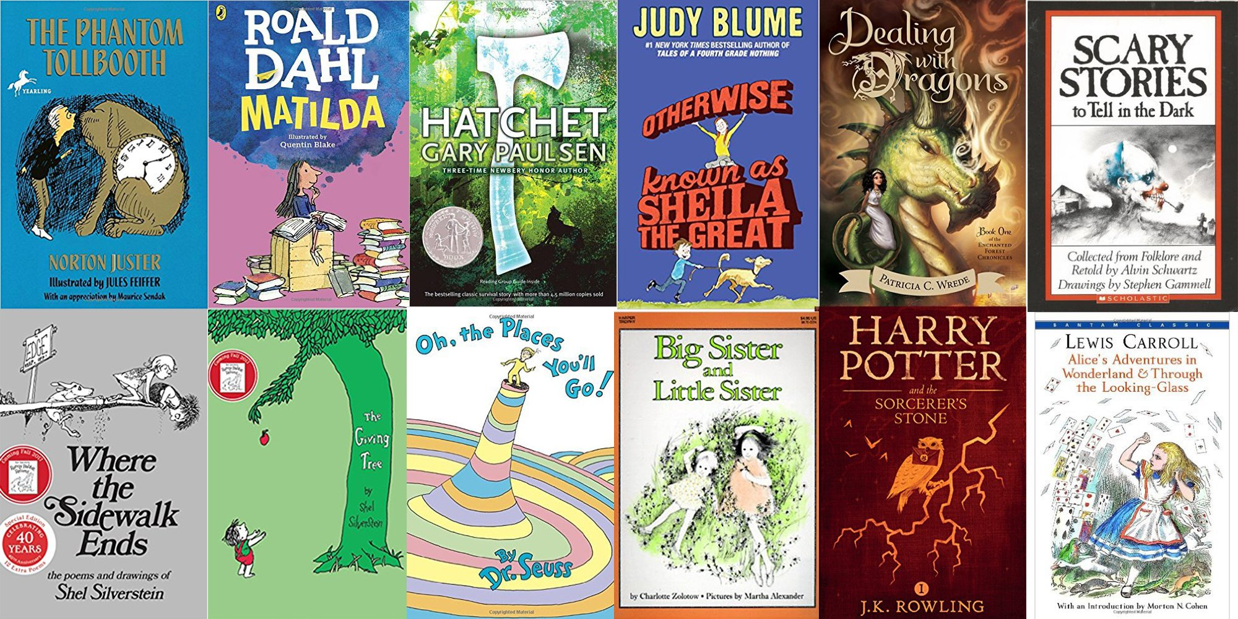
Reading
Workshop
KS2
Wednesday 8th November 2017

Slide 2
What our children say
I love our new school library! There are lots of amazing books. I love reading with my friends.
I love when the teacher reads to us – it’s so relaxing.
I love reading because I love finding new words and then you can find out what they mean.
My favourite place to read is in the book corner.
My favourite type of book is a story book because you can escape into your head.
I like it when Fred comes to read with us.

Slide 3
The power of reading
Creating a love of reading in children is potentially one of the most powerful ways of impacting on academic standards in school.
There can be few better ways to improve pupils chances in school, or beyond in the wider world, than to enable them to become truly independent readers.
Reading is all about acquiring meaning; for
enjoyment, information and understanding.
Notes:
If children are happy to read, they are more likely to do so when they have to as well as when they want to.
Our children will learn to read with confidence, fluency and understanding, providing them with the skills required to achieve a lifetime of enjoyment through reading.

Slide 4

Reading in School
The Teaching of Reading
The National Curriculum
“A high-quality education in English will teach pupils to speak and write fluently so that they can communicate their ideas and emotions to others and through their reading and listening, others can communicate with them.
Through reading in particular, pupils have a chance to develop culturally, emotionally, intellectually, socially and spiritually. Literature, especially, plays a key role in such development. Reading also enables pupils both to acquire knowledge and to build on what they already know.”
Notes:
Give a brief overview of the function of each of the above aspects of treading in school.
Explain that all of these are part of the teaching of reading.
Explain that sometimes, as parents, there is an expectation that children are heard reading often. This may be the case for some, but not all children. The hearing of reading is not the same as the teaching of reading.
Explain the school policy and expectations about home reading – in general. Details to follow,

Slide 5
What does the Early Years Outcomes say?
By the end of Reception, children are aiming to achieve the Early Learning Goals. For Reading it states…
Children read and understand simple sentences. They use phonic knowledge to decode regular words and read them aloud accurately. They also read some common irregular words. They demonstrate understanding when talking with others about what they have read.

Slide 6
National Curriculum in Year 1
During year 1, pupils develop their ability to sound and blend unfamiliar printed words quickly and accurately using the phonic knowledge and skills that they have already learnt.
The understanding that the letter(s) on the page represent the sounds in spoken words should underpin the reading and spelling of all words. Alongside this knowledge, pupils need to develop the skill of blending the sounds into words for reading and establish the habit of applying this skill whenever they encounter new words.
At the same time they will need to hear, share and discuss a wide range of high quality books to develop a love of reading and broaden their vocabulary.
Pupils should be helped to read words without overt sounding and blending after a few encounters.

Slide 7
National Curriculum in Year 2
At the beginning of year 2, pupils should be able to read all common letter sounds and group of letter sounds. They should be able to read unfamiliar words containing these sounds, accurately and without undue hesitation, by sounding them out in appropriate books.
Pupils will increase their fluency by being able to read these words easily and automatically. Pupils should be able to retell some familiar stories in the correct order that have been read to and discussed with them or that they have acted out during year 1.
During year 2, pupils should focus on developing accurate and speedy word reading skills. They should also listen to and discuss a wide range of stories, poems, plays and information books; this should include whole books using a variety of skills such as retrieval and inference.

Slide 8
National Curriculum in Year 3
By the beginning of year 3, pupils should be able to read books written at an age appropriate interest level. They should be able to read them accurately and at a speed that is sufficient for them to focus on understanding what they read rather than on decoding individual words. They should be able to decode most new words outside their spoken vocabulary, making a good approximation to the word’s pronunciation.
As their decoding skills become increasingly secure, they should develop their vocabulary and the breadth and depth of their reading, making sure that they become independent, fluent and enthusiastic readers who read widely and frequently. They should be developing their understanding and enjoyment of stories, poetry, plays and non-fiction, and learning to read silently. They should also be developing their knowledge and skills in reading non-fiction about a wide range of subjects.
They should be learning to justify their views about what they have read, with support.

Slide 9
National Curriculum in Year 4
During year 4, pupils should be able to read books written at an age appropriate interest level. They should be able to read them accurately and at a speed that is sufficient for them to focus on understanding what they read rather than on decoding individual words. They should be able to decode most new words outside their spoken vocabulary, making a good approximation to the word’s pronunciation.
As their decoding skills become increasingly secure, they should develop their vocabulary and the breadth and depth of their reading, making sure that they become independent, fluent and enthusiastic readers who read widely and frequently. They should be developing their understanding and enjoyment of stories, poetry, plays and non-fiction, and learning to read silently. They should also be developing their knowledge and skills in reading non-fiction about a wide range of subjects.
They should be learning to justify their views about what they have read with increasing independence by the end of year 4.

Slide 10
National Curriculum in Year 5
During year 5, pupils should be able to read aloud a wide range of poetry and books written at an age-appropriate interest level with accuracy and at a reasonable speaking pace. They should be able to read most words effortlessly and to work out how to pronounce unfamiliar written words with increasing ease. If the pronunciation sounds unfamiliar, they should ask for help in determining both the meaning of the word and how to pronounce it correctly.
They should be able to prepare readings, with appropriate intonation to show their understanding, and should be able to summarise and present a familiar story in their own words. They should be reading widely and frequently, outside as well as in school, for pleasure and information.
They should be able to read silently, with good understanding, inferring the meanings of unfamiliar words, and then discuss what they have read.

Slide 11
National Curriculum in Year 6
By the time they start year 6, pupils should be able to read aloud a wide range of poetry and books written at an age-appropriate interest level with accuracy and at a reasonable speaking pace. They should be able to read most words effortlessly and to work out how to pronounce unfamiliar written words with increasing ease.
They should be able to prepare readings, with appropriate intonation to show their understanding, and should be able to summarise and present a familiar story in their own words. They should be reading widely and frequently, outside as well as in school, for pleasure and information.
They should be able to read silently, with good understanding, inferring the meanings of unfamiliar words, and then discuss what they have read.
By the end of year 6, pupils’ reading should be sufficiently fluent and effortless for them to manage the general demands of the curriculum in year 7, across all subjects and not just in English, but there will continue to be a need for pupils to learn subject specific vocabulary.

Slide 12
Reading progression

Slide 13
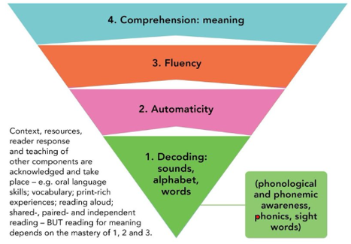
Reading skills

Slide 14
Reading skills
Understanding
The ability to understand the meaning of the words and sentences in a text.
The ability to understand the ideas, information and themes in a text.
If a child understands what they hear, they will understand the same information when they read.
Phonics and Word Recognition
The ability to recognise words presented in and out of context.
The ability to blend letter sounds (phonemes) together to read words.

Slide 15
Reading in School
The Teaching of Reading
Phonics
Shared reading
Whole class guided reading (VIPERS)
Independent reading
Focused reading activities
Reading across the curriculum
Class novels and stories
Reading for pleasure
The hearing of reading is NOT the teaching of reading
Notes:
Give a brief overview of the function of each of the above aspects of treading in school.
All of these are part of the teaching of reading.
There is an expectation that children are heard to read regularly at home. The hearing of reading is not the same as the teaching of reading.
Explain the school policy and expectations about home reading.

Slide 16
What is phonics?
Phonics is a way of teaching children how to read and write. It helps children hear, identify and use different sounds that distinguish one word from another in the English language.
Written language can be compared to a code, so knowing the sounds of individual letters and how those letters sound when they’re combined will help children decode words as they read.
Understanding phonics will also help children know which letters to use when they are writing words.

Slide 17
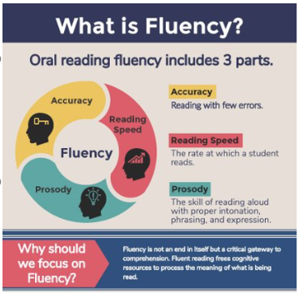
Fluency
Fluent reading supports reading comprehension. When pupils read fluently, their cognitive resources can be redirected from focusing on decoding and onto comprehending the text. For this reason, fluency is sometimes described as a bridge from word recognition to comprehension.​
If the brain’s processing power isn’t being used up by working out how to read a word, it can concentrate on understanding and enjoying the text.

Slide 18
Comprehension
Being able to read does not mean you understand what you read.
Your child might sound like a good reader but may not necessarily understand what the text means.
The best way to develop understanding is to talk about texts.
The next slide is easy to read – does anyone understand what it means?

Slide 19
An extract taken from a computer manual
According to the previous ATA/IDE hard drive transfer protocol, the signalling way to send data was in synchronous strobe mode by using the rising edge of the strobe signal. The faster strobe rate increases EMI, which cannot be eliminated by the standard 40-pin cable used by ATA and ultra ATA.
Why is this harder for us to understand?
Notes:
This slide shows that the ability to read aloud well is no indication of understanding.
Reading comprehension has to be taught.
Language has to be taught, defined, used and understood.

Slide 20
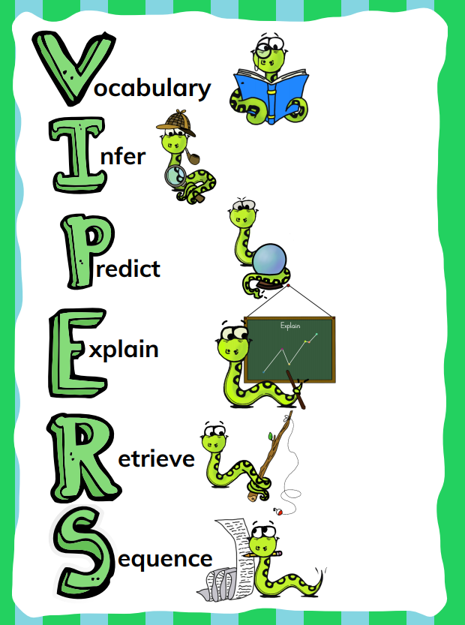
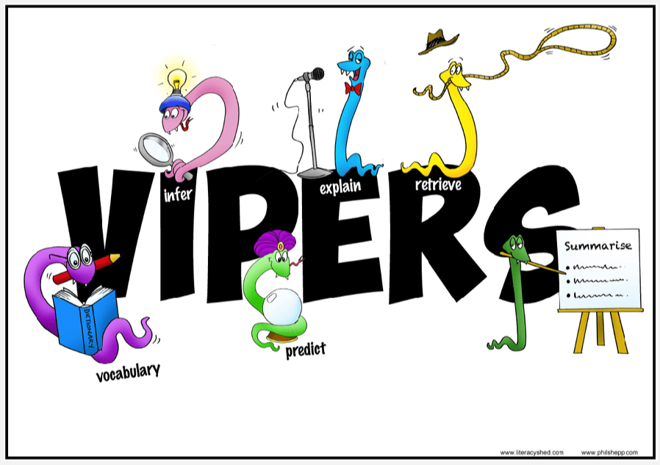
Whole School use of VIPERS to teach reading skills
Notes:
Vipers is an acronym to aid recall of the 6 reading domains that form the reading curriculum. They are key areas which children need to know and understand in order to improve their comprehension of texts.
These 6 domains focus on the comprehension aspect of reading and not on the mechanics of reading – decoding, fluency, prosody.
VIPERS is our new method that will replace READ to teach and develop secure comprehension skills. It is a way of ensuring that adults ask, and children are familiar with being asked a range of questions.
It allows teachers to track the question types being asked and pupils responses allowing for targeted questioning.

Slide 21
KS1 Year 1 & 2
VIPERS title | Content domain description
Vocabulary | draw on knowledge of vocabulary to understand texts
Infer | make inferences from the text
Predict | predict what might happen on the basis of what has been read so far
Explain | identify / explain key aspects of fiction and non-fiction texts, such as characters, events, titles and information
Retrieve | identify / explain key aspects of fiction and non-fiction texts, such as characters, events, titles and information
Sequence | identify and explain the sequence of events in texts

Slide 22
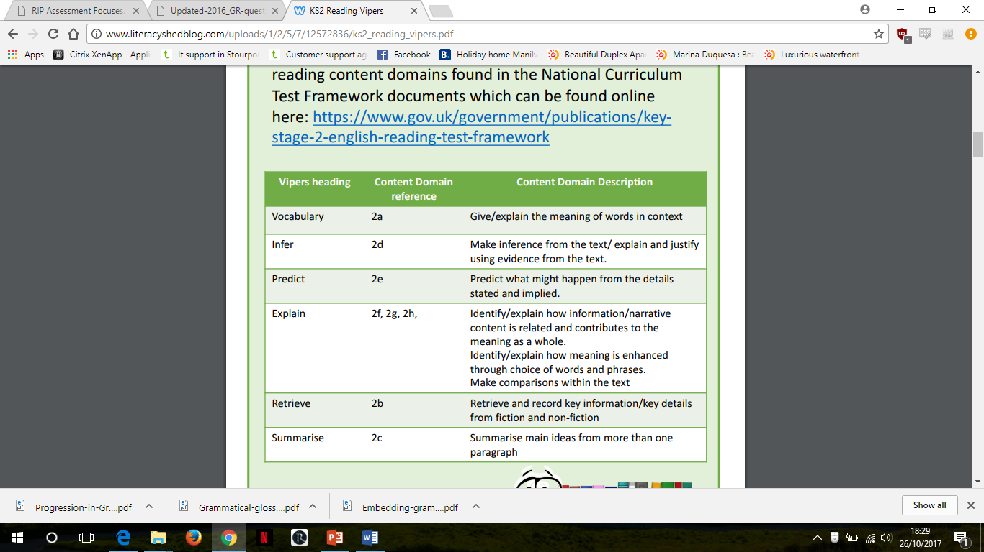
KS2 Year 3 - 6

Slide 23
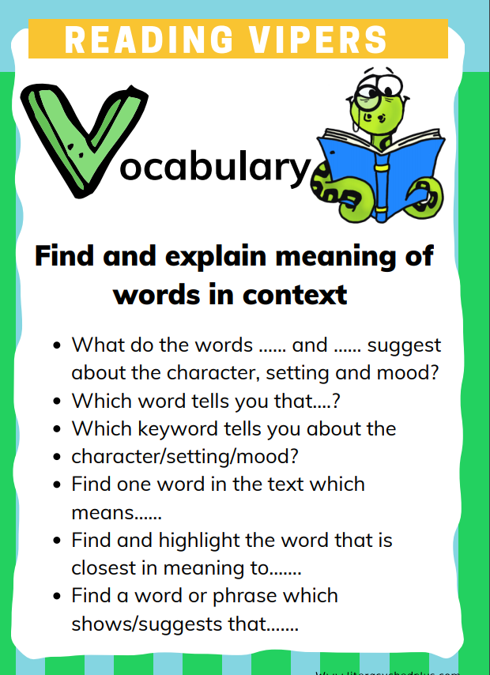
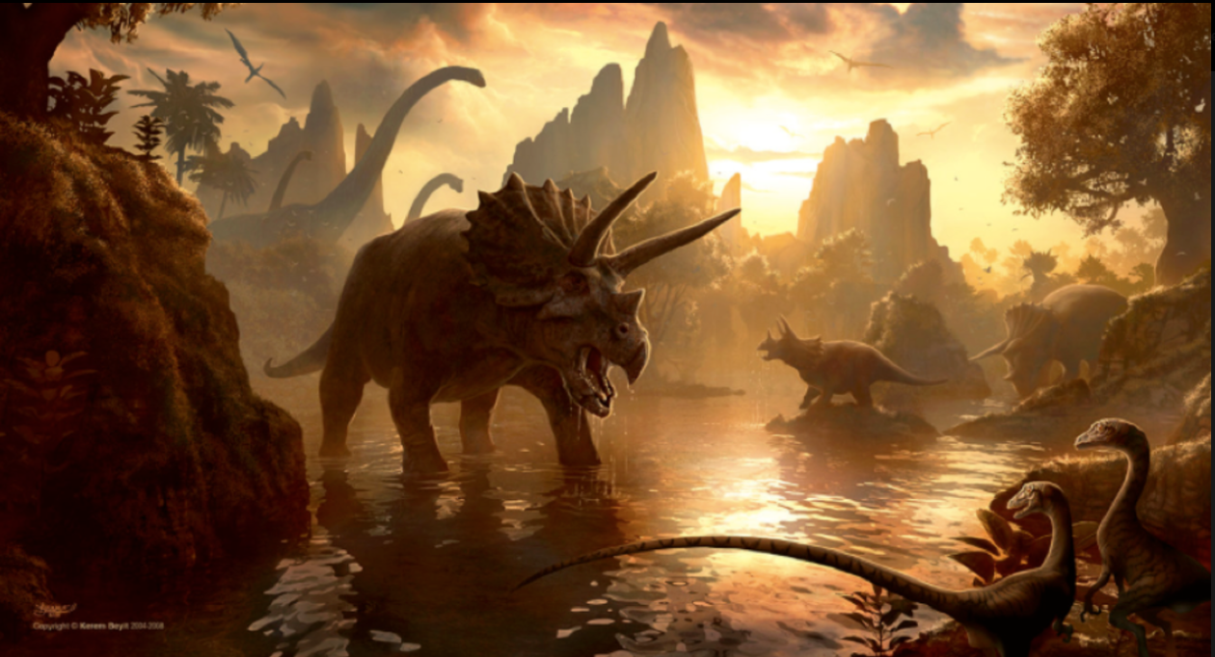
scolded |  | shaking in terror
trembling |  | walking confidently
exclaimed |  | something said in surprise
strode |  | being told off
nonsense |  | laughed at
scoffed |  | does not make sense
What adjective has been used to describe the shoe maker?
Match the word to the meaning
Circle the words that describe the dinosaur.
What does the word rich mean?

Slide 24
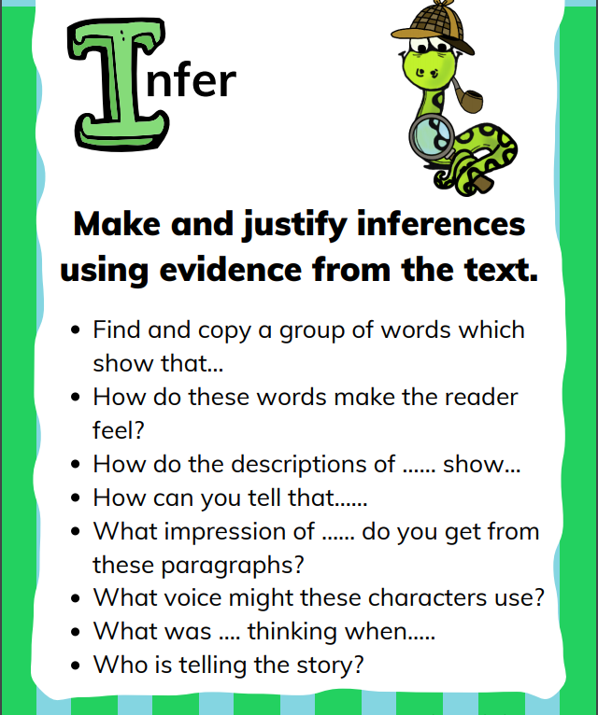
How do you think the shoemaker felt when he woke up to find new shoes?
Thinking about what we know about Elmer’s character, how do you think he will respond to the snow in this story? What sort of things do you think he will get up to?
Why might the fire have started in a bakery?
What do you think happened to the Mars cat after the story?

Slide 25
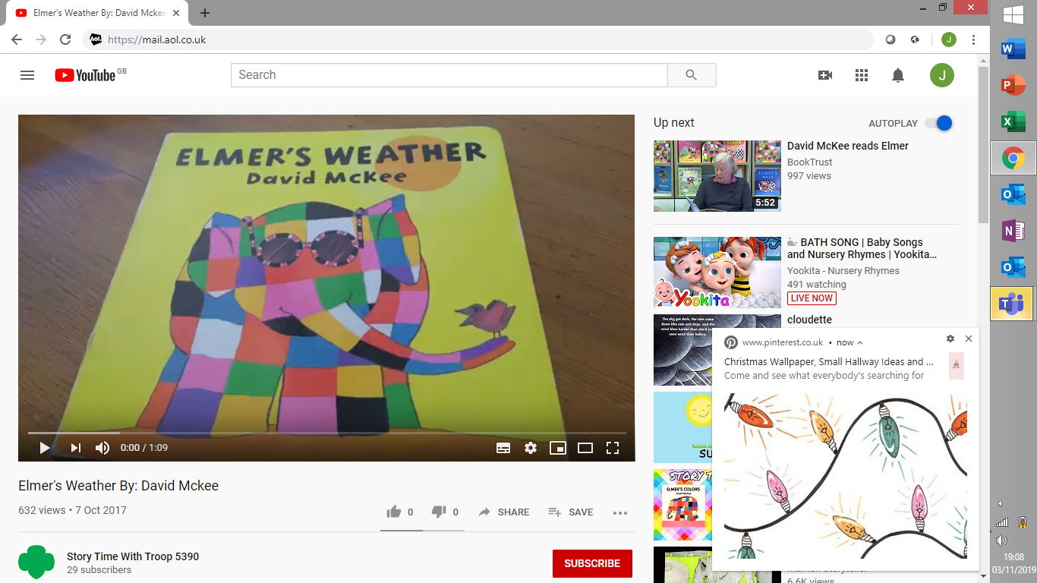
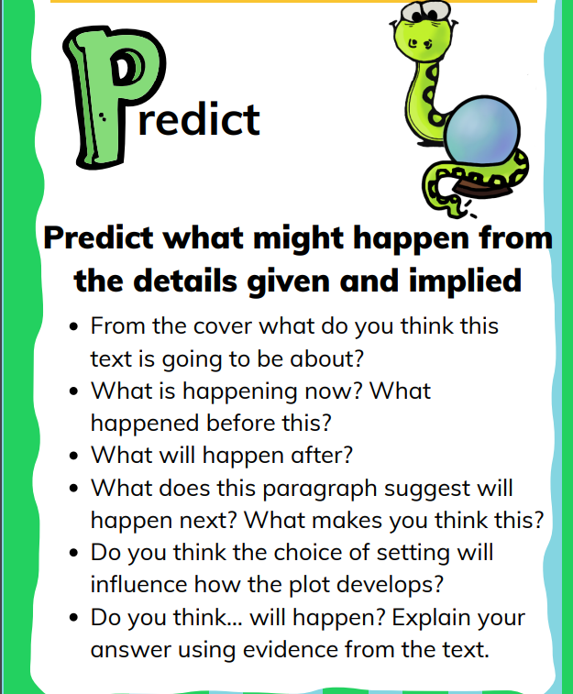
Predict what the story is going to be about.
What do you think will happen next?
Listen to the blurb. What do you think the story is about?

Slide 26
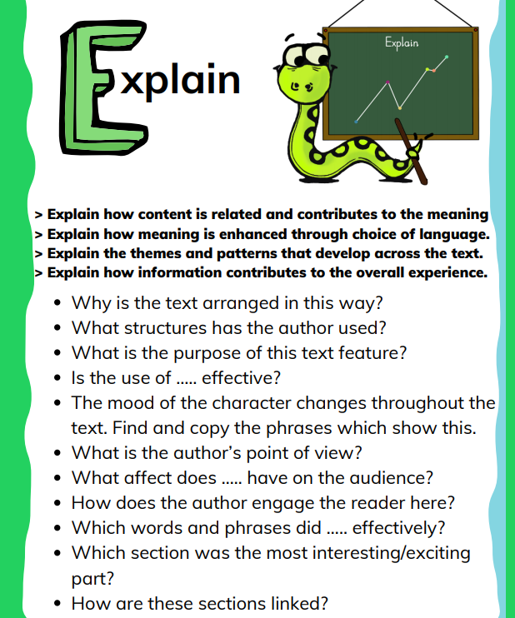
This week we have enjoyed reading ‘The Three Little Pigs’ in class.
What did you like most about the book?
Who was your favourite character? Why?
Was there anything that you didn’t like about the book?
Would you like to live in this setting?

Slide 27
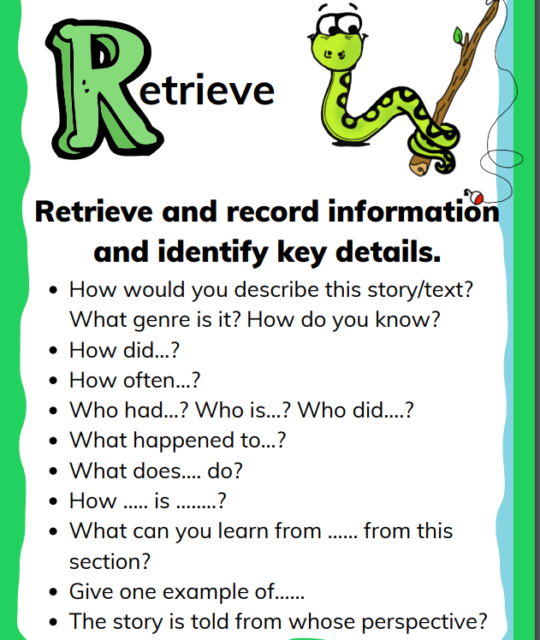
Why did Mummy pig tell the children they needed to build houses of their own?
They were too noisy
They were too big
They made too much mess
What information would be find on page 46?
Who were the pigs afraid of?
How did the rainbow become colourful again?

Slide 28
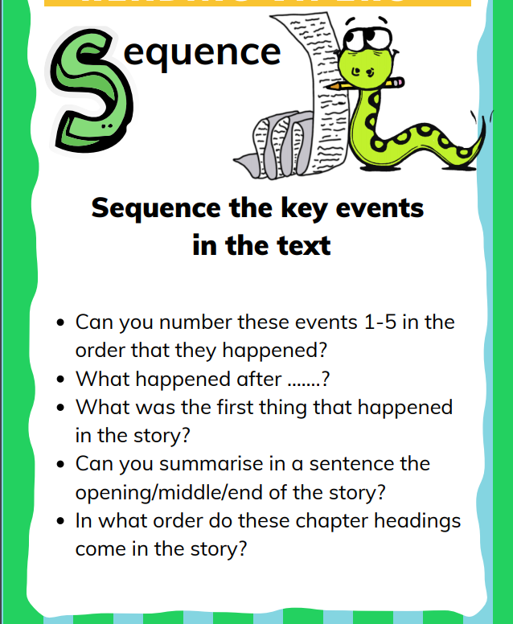
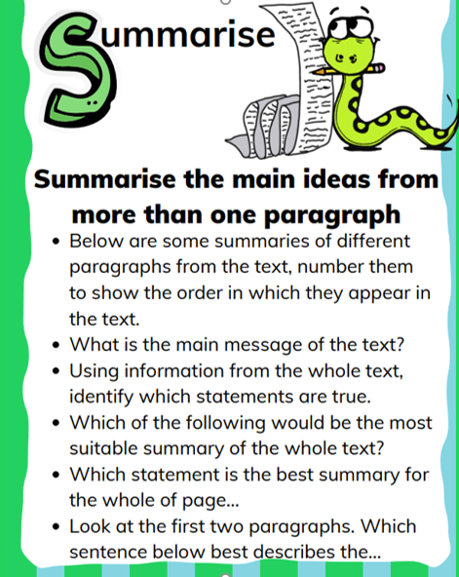
Can you sequence the pictures?
What happens next?
What happened first?
What happened at the beginning, middle and end of the story?

Slide 29
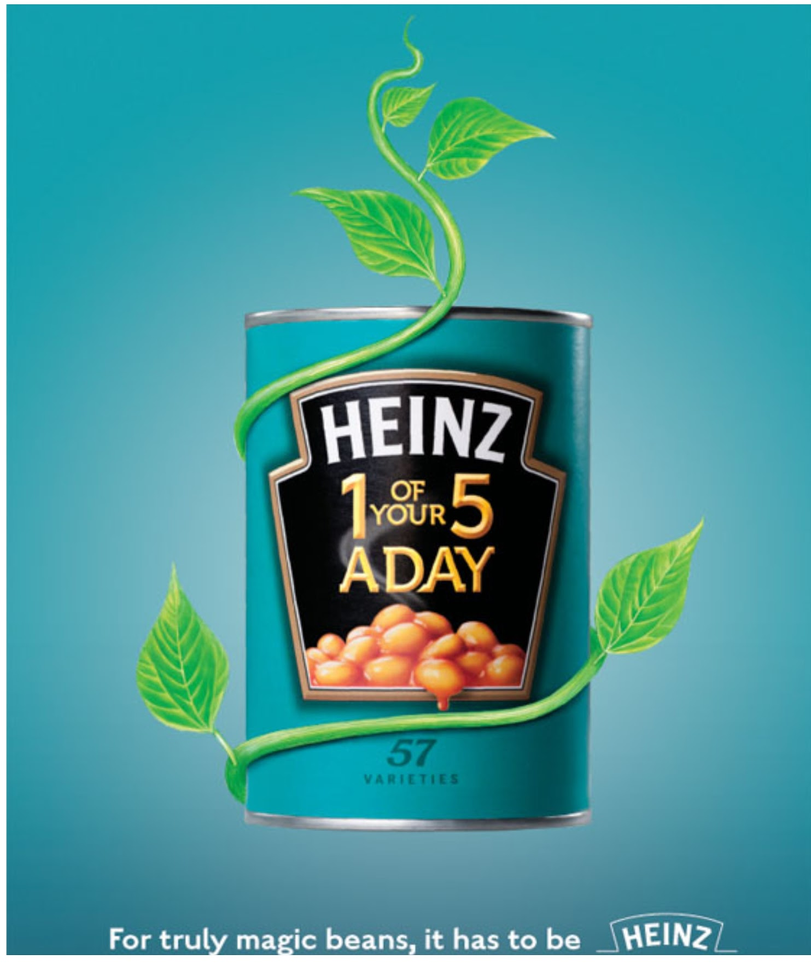
How many varieties of Heinz beans are there?
retrieval
What, on the advert, might persuade parents to feed this to their children?
inference
Explain what Heinz have done to make the beans appear to be ‘truly magic’ in this advert.
explain the author’s choices

Slide 30
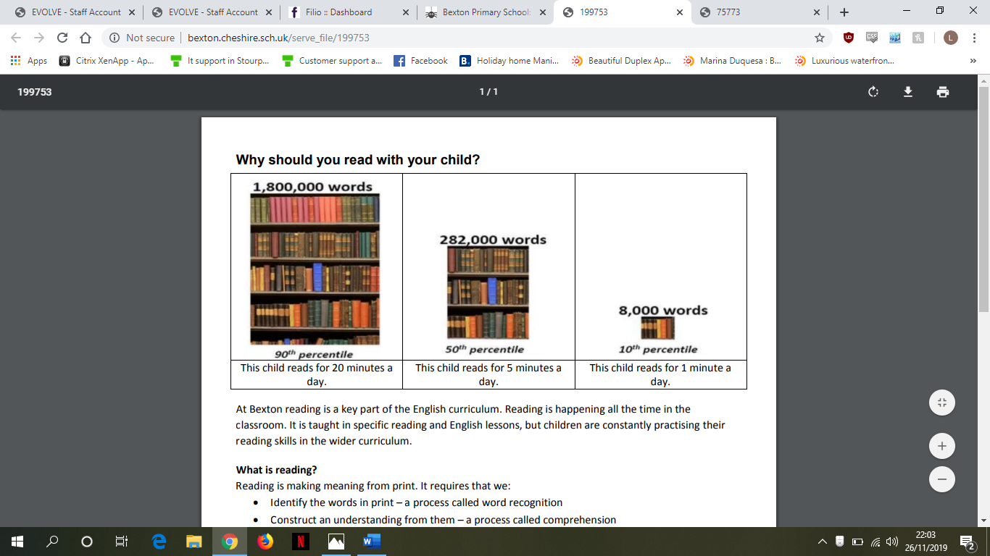
Reading at Home
Reading to children is an important way to help them build language skills. It exposes them to new words and ways of using language. It also helps them learn general information about the world, which makes it easier for them to succeed academically.

Slide 31
Reading at Home – Enjoy!
Make reading visible - have books available in your home
Share books every day – or as much possible.
Talk about books.
Sit and listen - don’t do chores around the reader!
Respect choices.
Model reading
Notes:
Respect choices – reading the computer or comics or sports magazines is still reading.
Share favourte boks

Slide 32
Talking about books
Do you like this book; why?
Who is your favourite character?
Tell me about a character in the book.
Which words tell you what the character is like?
How would you feel?
What do you think will happen next?
What would you do?
What have you learned about …… in your book?
What can you tell me about…?

Slide 33
Hearing your child read
Choose a quiet time and give your child your full attention
Give support if required Explain the meaning of new words;
Talk about the text using open questions.
Notes:
Reading aloud makes it easier to remember words than if you read them silently. This is key for young readers who are building their vocabulary. Oral reading also helps students build their reading speed, allowing them to read larger texts with ease.
Reading aloud has another big advantage—it’s a great tool for evaluating a child’s reading ability. Listening to your child read aloud can help you determine how well they are reading and where they may need to improve. Here are three key areas to help you measure your child’s reading ability through oral reading.

Slide 34




Sharing books
It is also important to read to your child. This is an opportunity for them to hear stories and be exposed to language at a higher level than when they read alone.
Research shows that hear texts read aloud is a significant source of vocabulary acquisition. Adult spoken language ranks lower in word complexity than that found in children’s books.
Notes:
Make it fun

Slide 35


Reading for pleasure
Reading for pleasure engages the imagination. Research shows it has other far-reaching benefits such as improving literacy, social skills, and health and learning outcomes.
Notes:
Reading for pleasure is important for children because it sparks their imagination, improves their empathy and helps them learn to love learning.
Reading for pleasure is also important for children because it helps them develop essential literacy skills.
Overall, reading is crucial for learning and development.

Slide 36


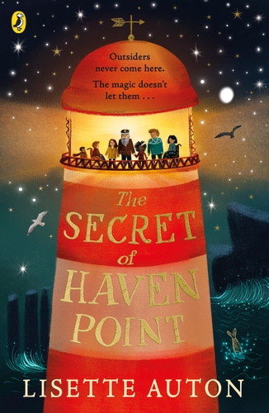

Before reading
If it is the first time your child has read the book, look at the cover and title with them to predict what they think the book might be about. Make links to other books read with similar themes, the same characters and/or similar authors/illustrators. Give them time to flick through the book and read the blurb.

Slide 37
During reading
•Encourage children to track the words with their finger or use a reading ruler.
•Help the children to decode (read) the words and ask them about the meaning of more challenging words.
•Ask children about the content of what they have read – who, what, where, when, why, how?
Always use your own parental judgement. If your child is tired or feeling unconfident, shift the balance of reading more towards you.

Slide 38
After reading
•Discuss and engage, mark it’s importance.

Slide 39
Homework expectations
As part of their weekly homework challenge, we encourage children to read regularly at home and ask that you sign their reading comment book at least 3 times every week.
We want you to be committed to:
Reception, Year 1 and Year 2 children will need to read at least 3 x a week for 10 minutes
Year 3 & 4 children will need to read at least 3 x a week for 20 minutes
Year 5 & 6 children will need to read at least 3 x a week for 30 minutes.

Slide 40
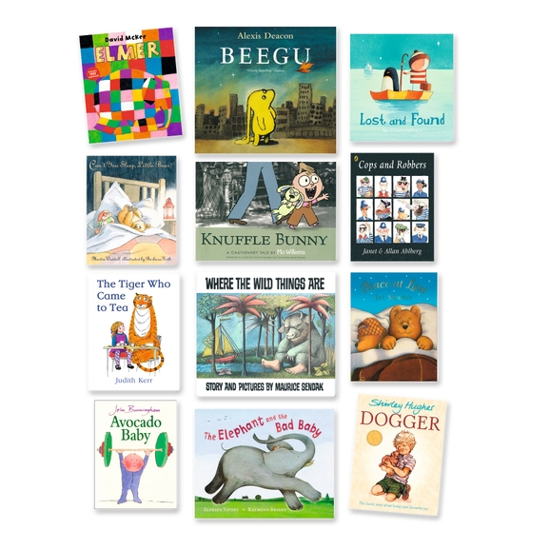
Recommended books
Publish recommended reads of high quality texts in our news bulletin and on our website. These books are promoted in school as Fred’s recommended reads.

Slide 41
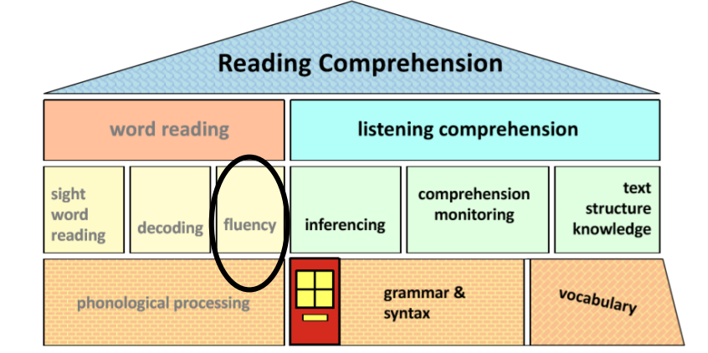

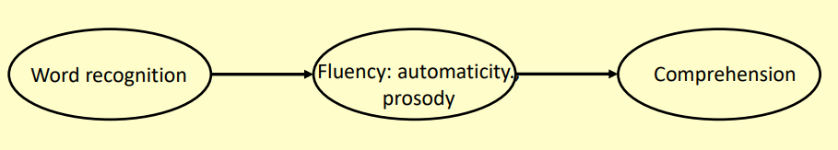
Successful readers
Notes:
Reading is a skill that most of us take for granted, yet is one that is essential for being able to get on in life.
As a child grows up, being able to read well not only enables them to discover new facts and to learn at school, but also opens them up to a world of new ideas, stories and opportunities.
As research shows, children who read for pleasure will achieve more than those that don’t in later life.
All the decisions we make as a school on reading, are based on research – we are well informed and up to the minute. All our staff are committed to ensuring that all children become independent and fluent readers during their time at our school. We want our children to enjoy books as much as we do!

