Slide 1

PGL Barton Hall 2026
22nd – 26th June

Slide 2
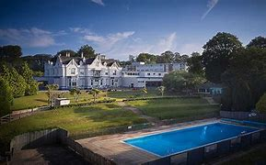
PGL Barton Hall 2026
22nd – 26th June
Miss Trussell
Mr Ensby
Mrs Picot
Mrs Fetherston
Miss Kennedy

Slide 3
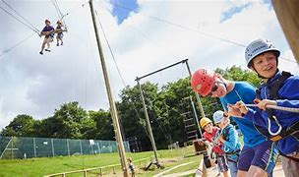
Barton hall
A coastal retreat, at the heart of the English Riviera, Barton Hall adventure activity centre is a great location in South Devon. Within the grounds, there are all the adventure activities your group could want – abseiling, climbing, zip wire, giant swing and lots more! All designed to get everyone working together, giving help and support and building confidence.
There are some great facilities too, including a lake for watersports, an indoor activity zone and an outdoor heated pool.

Slide 4
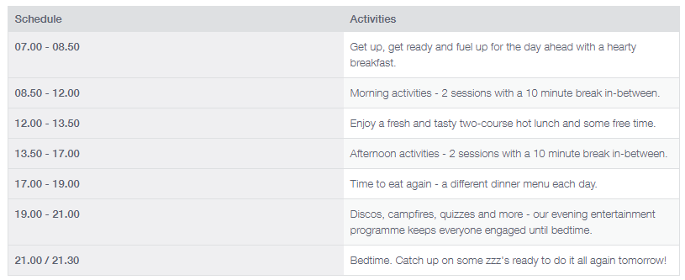
Activities
4 activities + evening entertainment each day
Abseiling
Orienteering
Swimming
Climbing
Rifle shooting
Raft building

Slide 5
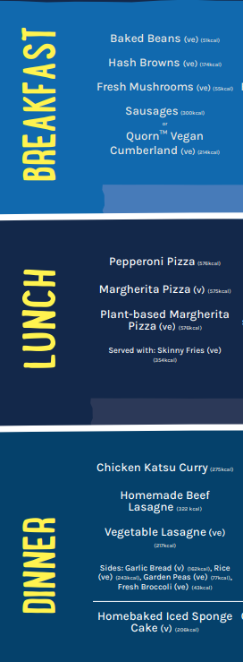
Food
3 meals a day provided by Barton Hall
Vegetarian/ Halal options available
Salad bar and fruit

Slide 6
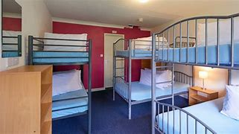
Accommodation
En-suite rooms
Boys and girls will be separate
6 children per room
Adult rooms are in the same corridor
Bedding is not provided

Slide 7
Packing - please take a suggested packing list home
Bedding – sleeping bag, pillow/ pillow-case
Wet shoes
NO crocs
Snacks
NO money
NO Electronics – phones, smart watches etc
Perhaps a smarter outfit for the last night

Slide 8
Morning of
Arrive at school as normal
Drop bags/ medical in the front hall, then children go to classrooms
Small day bag (including packed lunch) to have on the coach
Start loading the coach at 9:00
Stopping for a lunch break
Please do come and wave us off!

Slide 9
Medical
Please bring ANY medical in a labelled bag (including name, dosage and administering instructions) and give to office the week before if possible.
THIS INCLUDES CALPOL.
Health care plan and parent permission form

Slide 10
Photos and communication
1 picture on Facebook each morning
ALL pictures will go on the school cloud where the children can log in and see them
Permissions for photos on Facebook and shared photos
We will not take any pictures of children that do not have consent
We will be in regular communication with Ms Astley and school.

Slide 11
Questions?

