Slide 1
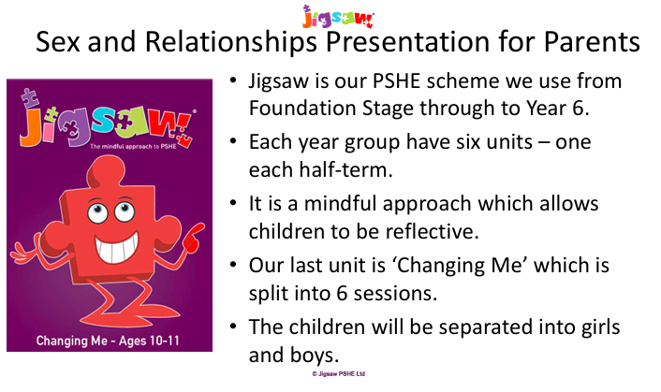
Notes:
Mr Ensby takes the boys and Miss Trussell takes the girls – helps the children to feel more comfortable to ask questions. PSHE usually completed in 2 sessions – depends how many questions the children have. Aim to do sessions 1-3 on one day and 4-5 the next. We show the children both animations. Although boys and girls are in separate classrooms, the lesson content is the same.
Session 6 links to transition so it completed separately and in normal classes.

Slide 2
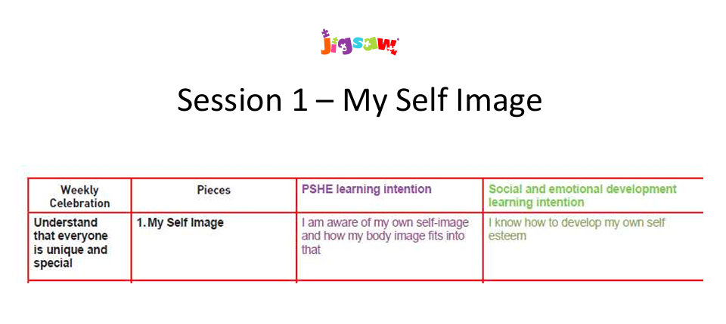
Notes:
Linking in with self-esteem and body image.

Slide 3
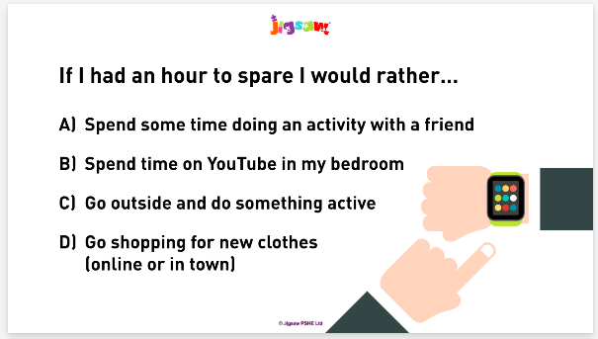
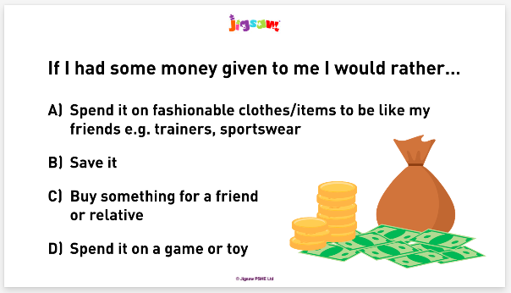
Notes:
Some of the activities included.

Slide 4
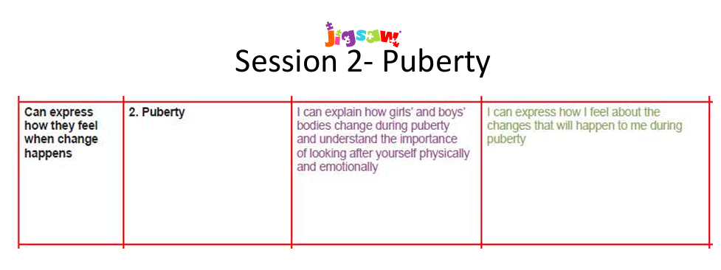
Notes:
This session usually takes the longest. It recaps and builds on what was covered in Year 5. We want the children to understand what is happening to their bodies from trusted adults rather than hearing myths from the children. It is important for the children to understand what is happening and to understand that it is normal and happens to everyone.

Slide 5
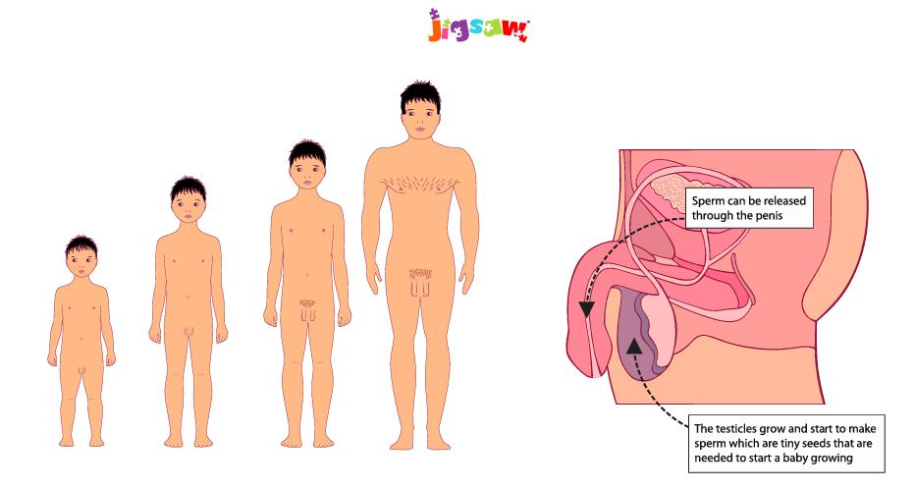
Notes:
Some of the images in the lesson.

Slide 6
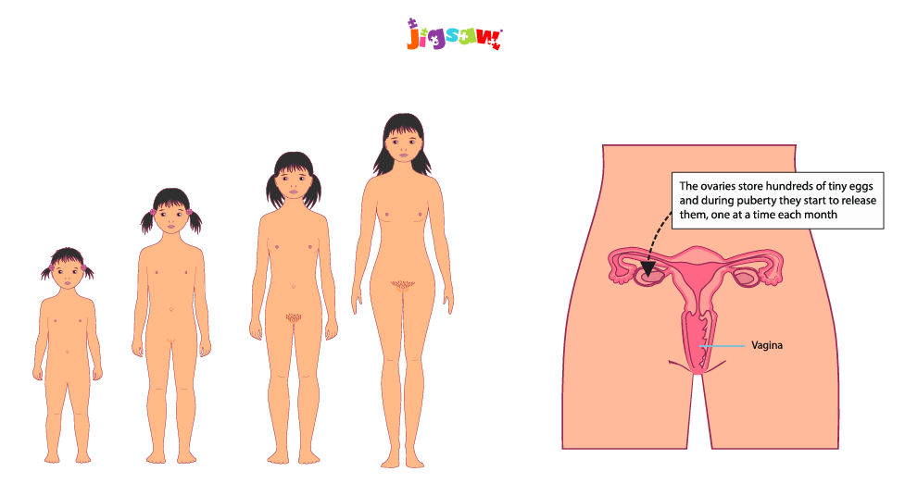
Notes:
Some of the images in the lesson.

Slide 7
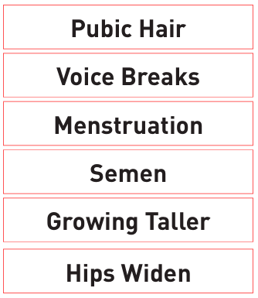
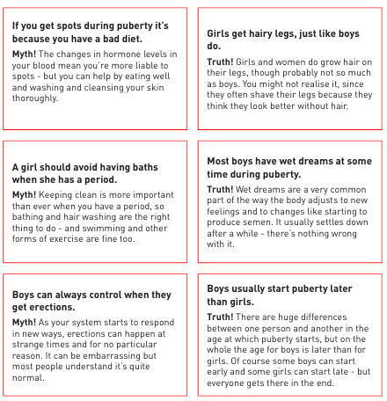
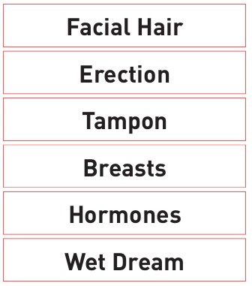
Notes:
Some of the vocab used in the lesson. Activities include: do the changes happen to girls, boys or both, True or Myth.

Slide 8

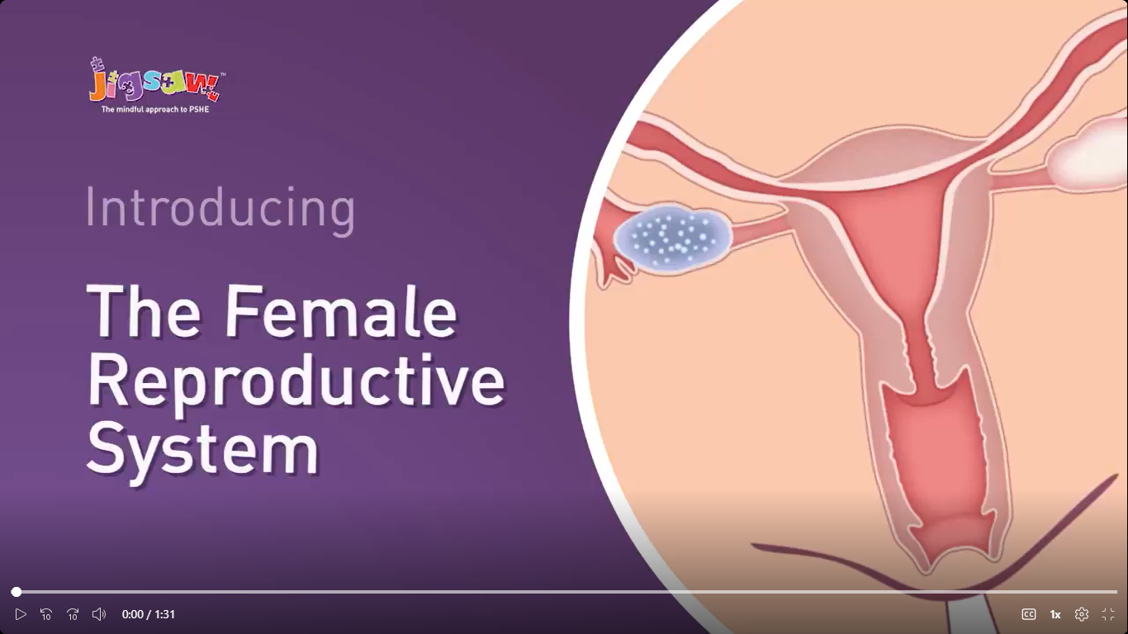
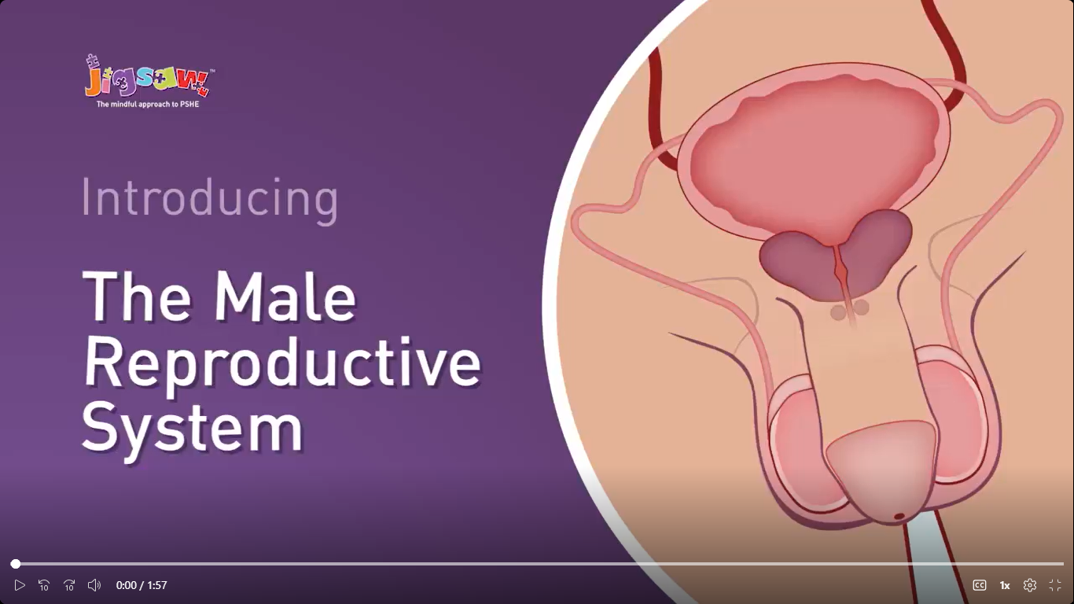
1st-ages-9-11-female-with-narrative.mp4
2nd male-full-animation-with-narrative.mp4
Notes:
We show the children both animations. Although boys and girls are in separate classrooms, the lesson content is the same. It is important to understand what is happening to both genders during puberty.

Slide 9
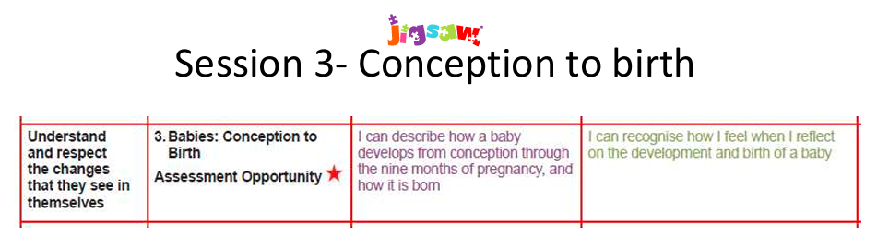
Notes:
We tend to get questions about twins, IVF, surrogates and donors in this lesson, adoption often comes up too. We discuss that some people struggle/ can’t conceive a baby naturally but there are other options.

Slide 10
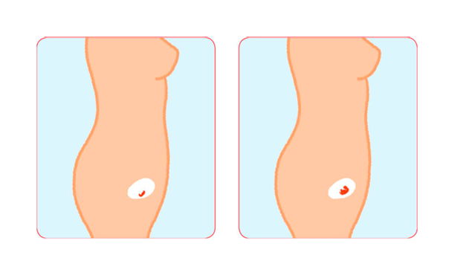
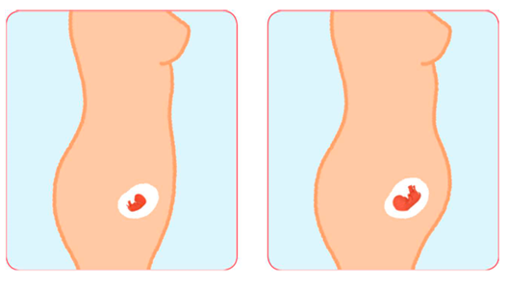
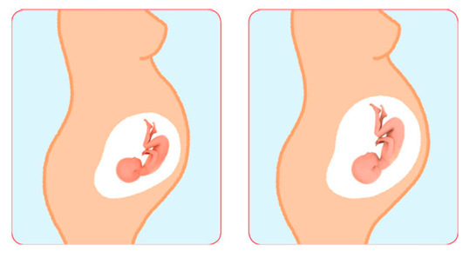
Notes:
Some images shown to the children.

Slide 11
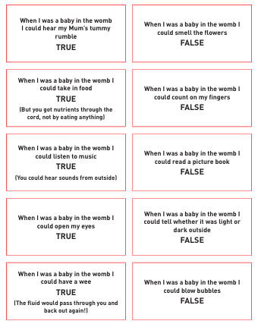
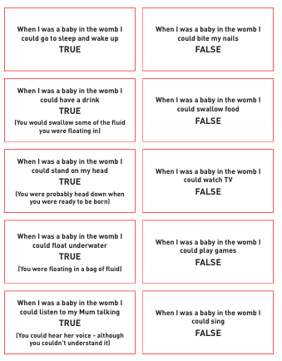
Notes:
The lesson includes a true/ false activity.

Slide 12
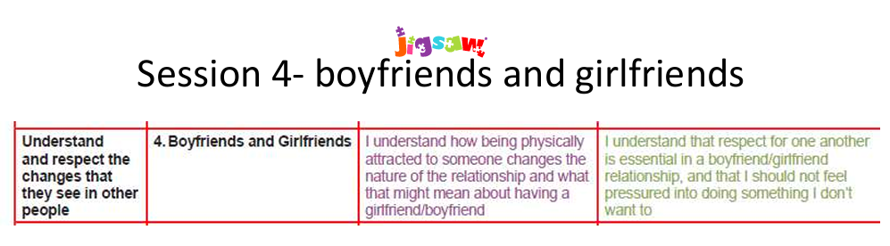
Notes:
Respect, peer pressure and age appropriate actions are mentioned in this lesson.

Slide 13
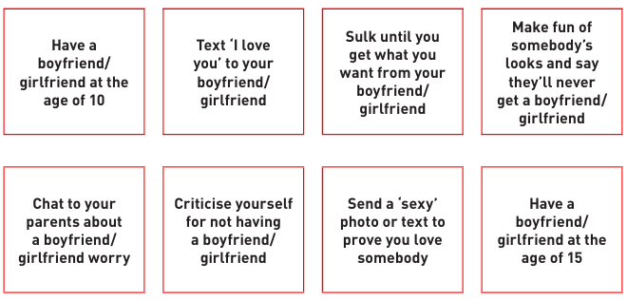
Notes:
One of the activities in the lesson is Ok/ Not Ok.

Slide 14
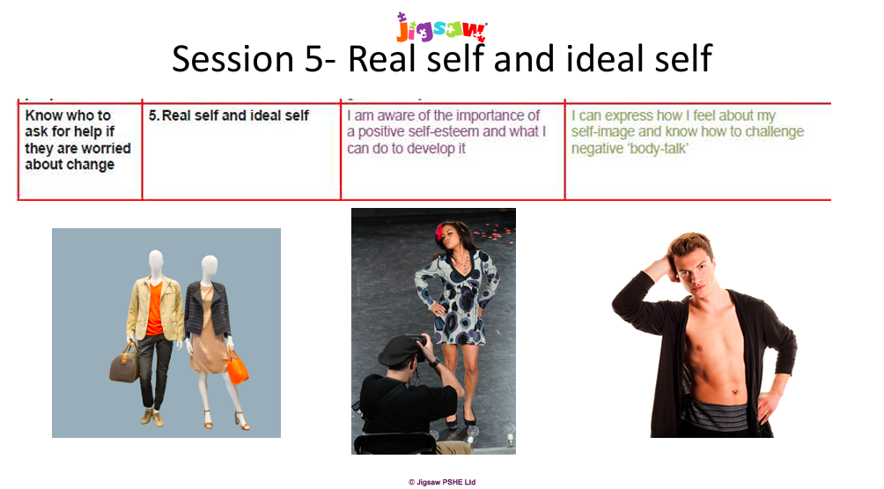
Notes:
Similar content to lesson 1 – normal, unique and self esteem.

Slide 15
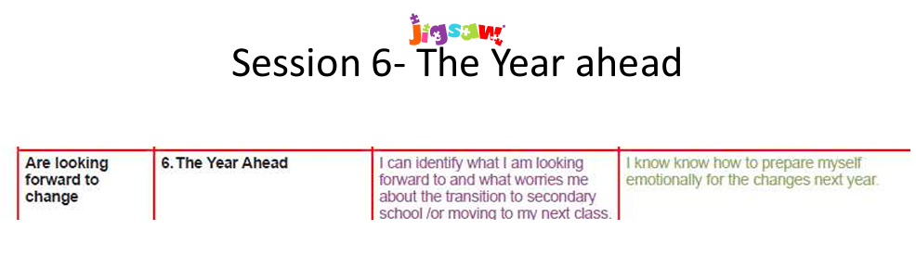
Notes:
Done in normal classes separately to the rest of this unit – links in with transition.

Slide 16

We strongly encourage all children to take part in these lessons, as
they support wellbeing, confidence and healthy development.
However, parents do have the right to withdraw their child from the sex
education elements of the unit that go beyond the National Curriculum
for Science (primarily in Years 5 and 6). The statutory Science content,
such as learning about life cycles and basic body changes, is
compulsory for all children.
If you would like further information about the curriculum or the
withdrawal process, please visit the school website or contact the
school office.

